Slide 1
Brexit and EU/EFTA Citizen Rights
Guide to the European Settlement Scheme
By Sarah Woods & Mathew Wong
23rd October 2019

Slide 2
Who are we?
Sarah Woods is a Senior Adviser (International) based in the SU’s Student Advice Centre and provides advice on immigration routes including EEA residence, EU settlement, post study work, family and settlement visas.
Mathew Wong is an adviser in the International Student Support team, advises and supports international students in relation to Tier 4 and EUSS applications.

Slide 3
What is aim of the session?
To provide
Brexit update
EU/EFTA citizen rights (Deal & No Deal)
Provide an overview of EU Settled Status Scheme (EUSS) and how to apply
Details of further advice & support from SU & University
Q & A’s- we will do our best to answer them!

Slide 4
Brexit Update
Withdrawal Agreement V2 agreed by EU 27 and UK Government last week.
If ratified by Parliament UK to leave EU with transition period up to 31.12.2020.
On 22.10.19 Parliament voted in favour of Withdrawal Agreement Bill but rejected short timescale for debate.
Further extension now seems likely to 31.1.2020 or sooner if Parliament ratifies it.

Slide 5
Brexit Update continued-
Bill has now been paused
If it is debated likely to be amended
Further extension of Article 50 now likely
Boris Johnson has said he will call for General Election…
Who knows what could happen then ??
Peoples Vote/Revoke Article 50/No Deal
More uncertainty, but what do we know about EU Citizen Rights?

Slide 6
Current EU Citizen Rights
Current Eu Citizen Rights and Freedom of Movement enshrined in EU treaty (Dir2004/38/EC)
This applies until UK officially leaves EU
After 3 months in UK, EU citizen should be ‘exercising treaty rights’ to work, study, or be self sufficient (Students also need CSI)
Can apply for registration card or permanent residence after 5 years but did not have to!
Non EU family members can apply family permit & residence card to help prove rights

Slide 7
How does Brexit affect EU Citizen rights?
Brexit will mean the end of FOM and end to citizen rights enshrined in EU treaty (Directive 2004/38/EC)
See Part 2 of Withdrawal Agreement Bill deals with EU Citizen Rights
EU citizens will have to register under EUSS to protect current rights to live, work and study in UK
UK has already introduced EU Settlement Scheme for EU citizens and their families.

Slide 8
What if there is No Deal?
UK Govt has published policy intention to commit to EUSS in event of No Deal
EUSS will still apply (some changes and less generous in relation to family members but largely the same)
EU citizens should apply by 31.12.2020
Concern that EUSS does not have statutory protection as yet
Could be changed through secondary legislation in future!

Slide 9
EU Citizens resident in UK before Brexit
Can apply for EUSS and will have until 31.12.2020 to do so.
Up until 31.12.2020 they can continue to take up employment, rent property as now by simply showing their passport or national identity card.
Their rights to claim benefits and access services in the UK will remain unchanged.

Slide 10
Who can apply under EUSS?
EU 27 citizens;
Citizens of Norway, Lichtenstein, Iceland (non-EU EEA citizens);
Swiss citizens;
eligible family members of all of the above
eligible family members of British citizens who have exercised a right to reside in another EU country (Surinder Singh)
Zambrano, Chen carers
Notes:
EU appendix, guidance, policy paper

Slide 11
Who are Family members?
Direct family - Spouse, Civil partner, durable partner, Dependant children (& future children)
Extended family members such as Dependant parents, grandparents, grandchildren
Covered if relationship existed by 31.12.2020 (31.10.19 if no deal)
All other extended family members must be residing in UK by 31.12.2020 (31.10.19 if No deal)
Some protection for non EU nationals who were family members e.g. divorced, widowed, carers of EU children
Can be complex area, please seek further advice from Student Advice Centre email advice@shef.ac.uk to make appointment.

Slide 12
Who will not need to apply?
Irish citizens will not be required to register under EUSS as they have right to residence under Common Travel Area
(Non Eu family members of Irish Citizens will need to apply)
EU citizens who already have Indefinite Leave to Remain (*)
EU Citizens with Permanent Residence will need to apply

Slide 13
Should you apply?
Do you want to protect your existing right to continue living in UK with right to work, study?
Are you planning to stay in UK longer term?
Its free and fairly straightforward to do so
Keeps your options open for future study, work
Do you have non EU family members?
May help prove status in a ‘hostile environment’
Seek further advice if you have any serious criminal convictions as this could be reason for refusal.

Slide 14
What happens if you do not apply?
IF UK does leave EU, you would have to leave by end of December 2020
OR apply for new immigration status called Temporary Leave to Remain (max 3 years)
Or apply under a different UK immigration route (likely to be tougher requirements and more expensive)
Govt announced plans for major reform of Immigration system from 1.1.2021

Slide 15
When to apply for EUSS?
You can apply now, scheme fully rolled out from 30.3.19
No rush, you can apply up to at least 31.12.2020
Think about personal situation and when it suits you
Can apply in and out of UK
Look out for EUSS application workshops or book 1:1 app with SAC/ISS

Slide 16
EUSS- Pre-settled Status
Granted if less than 5 years residence in UK
Time limited, will need to apply again for settled status when 5 years reached & before pre- settled status expires
Allows you to leave UK for up to 2 years and protect current rights
May be worth applying for pre settled status even if close to 5 years
-
Notes:
Explain CR

Slide 17
EUSS-Settled-Status
Similar to Indefinite Leave to Remain in UK
This will be granted if you can prove 5 years Continuous Residence (CR)
If you have Permanent Residence under current EU law you still have to apply under EUSS but should get settled-status
If you will reach 5 years CR before end of transition, can wait and apply once for settled-status
Will allow you to leave UK up to 5 years without losing status/rights.
You can apply for British Citizenship after 1 year of SS

Slide 18
What is Continuous Residence?
No absence more than 6m out of any 12m period
One 12 month absence OK if important reason ● childbirth ● serious illness ● study ● vocational training ● overseas posting ● any period of compulsory military service (Seek advice before applying if this applies to you)

Slide 19
What do you need to apply?
Valid biometric passport or biometric national ID card from 30.3.19
If applicable: UK issued BRC (non-EU family member of EU citizen)
Android phone (min vs 6.0, NFC enabled)
I Phone 8 or newer should also work
If you do not have biometric ID now possible to apply online at https://apply-for-eu-settled-status.homeoffice.gov.uk/web-or-app

Slide 20
How to Apply
Enable NFC on your phone
Download the UKVI app (EU exit ID document check)
Verify your identity via the app (scan passport and take a picture)
Complete application on your phone or computer (you will be sent code to log in)
Notes:
NFC – go to settings, type nfc into search field, make sure it’s activated
Go to Google play store – type EU E

Slide 21
Using the app
Provide contact details
Verify your email
Receive PIN via sms
Enter PIN to continue
Scan your passport
Scan face
Take a photograph

Slide 22
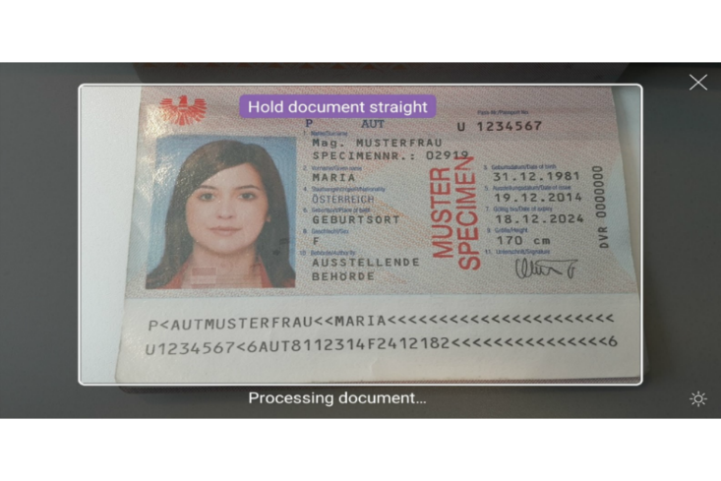
Scanning photo page
Follow prompts on app
If you are having problems, try taking the photo at arm’s length

Slide 23
Place phone on passport
Remove any covers from phone or passport
Click “check now”, place device on top of document
After 3 unsuccessful attempts – locked out for 1 day
Move device around document until app recognises it
Tip: place top half of phone
on bottom half of passport
Notes:
If not working – send passport by post

Slide 24
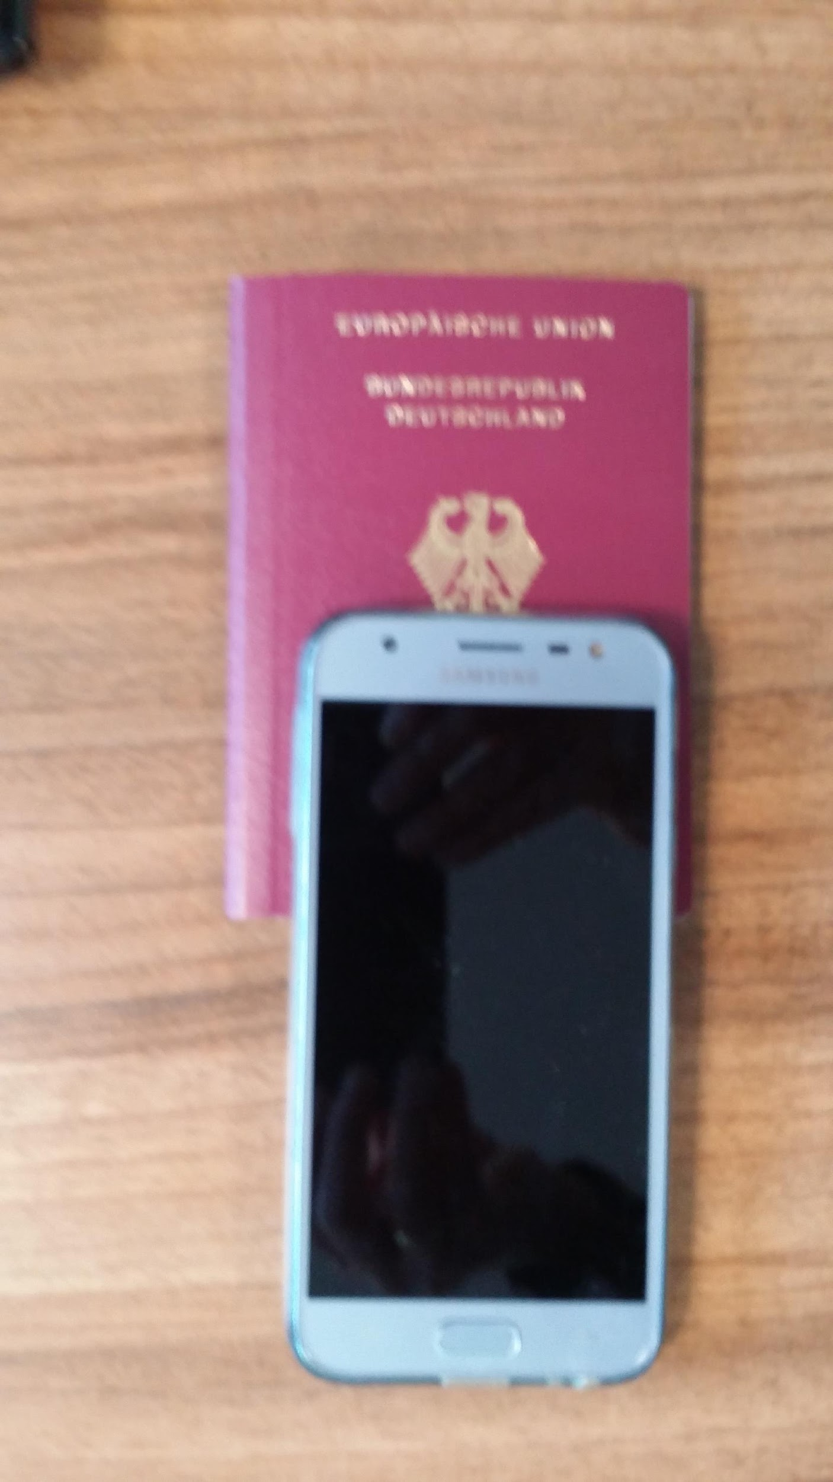
Place phone on passport
Notes:
If not working – send passport by post

Slide 25
Continue application
888.Answer questions about yourself (passport number,
nationality etc)
Answer questions about criminal convictions*, terrorist activities
Answer security questions
Provide NI number (if applicable)
Provisional result if settled or pre-settled status
If a) you don’t have a NI number OR b) you think you should have settled status but NI record doesn’t cover last 5 years – option to upload further documents
Notes:
*see advice
**Get refund

Slide 26
Examples of Docs Longer periods of residence
Annual bank statement (at least 6 months transactions)
Council Tax letter
Letter/Cert from school, college, university
Letter from Student Finance England
Letter from employer
Not an exhaustive list!
https://www.gov.uk/guidance/eu-settlement-scheme-evidence-of-uk-residence

Slide 27
Examples of Docs Shorter periods residence
Will cover month they are dated from
Utility bills
GP or hospital appointment card /letter
Payslip
Passport stamp
Used travel ticket showing entry to UK
Letter from a government department, public service or charity

Slide 28
Docs which you cannot use
photos and videos
letters or references from family and friends
greeting cards,
postcards sent or received
personal scrapbooks

Slide 29
What’s next?
Receive email confirmation of payment and application
Within ? Days you receive an email with the decision letter attached
Average length of time currently 10 days
Up to now decisions have been fairly quick but this could change
Decision letter tells you your status and includes a link to the online checking service
Notes:
*see advice
**Get refund

Slide 30
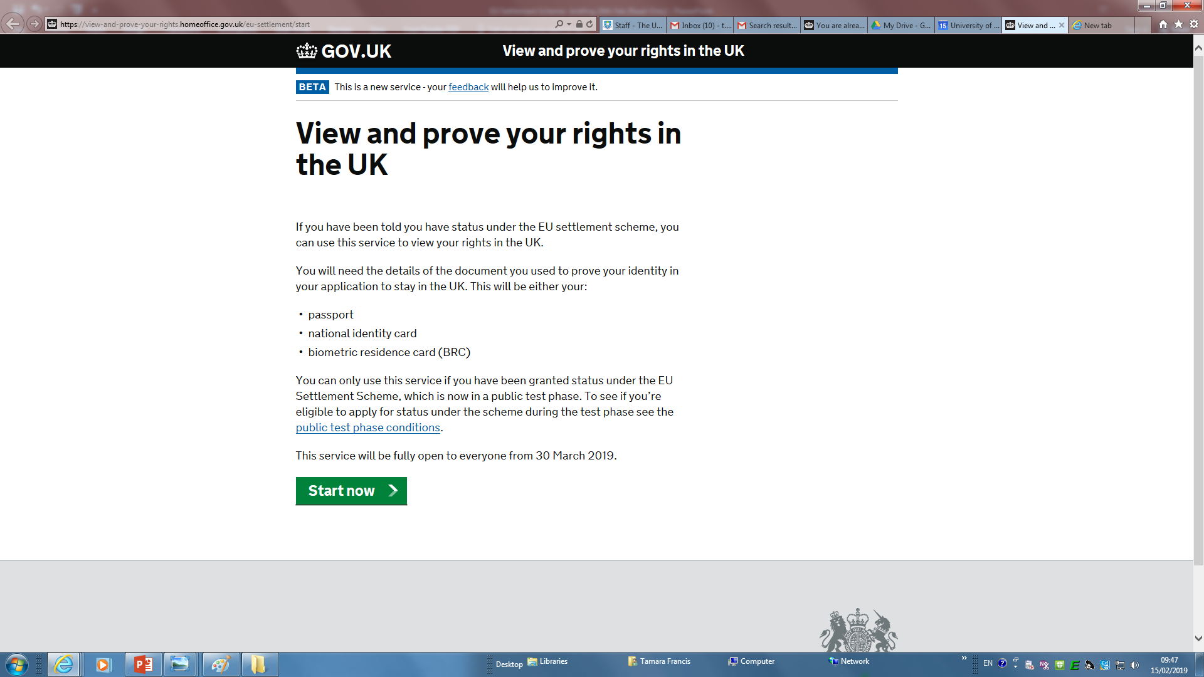
Type in passport number & date of birth, receive code by text or email and type it in

Slide 31
How will I prove my status
Evidence of pre settled or settled status is in digital form for EU citizens
Accessible via ID number, D.O.B and 2 stage verification code)
It will display name, photo, personal details
Show type of status and provide rights
Can be shared with third parties via email or access code (e.g. employer)

Slide 32
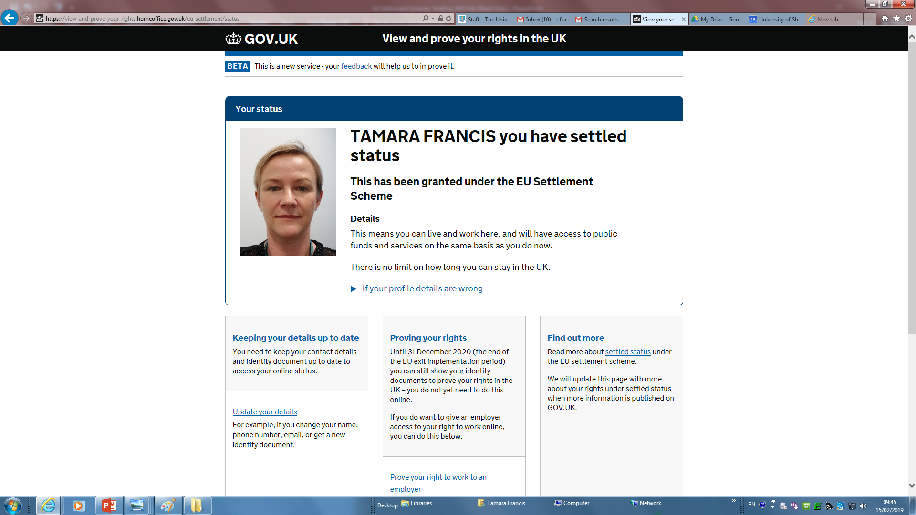
Your status is displayed like this

Slide 33
What support can you get with application?
Free1:1 Advice from International Student Support Team (individual EU students)
Family & complex cases should contact Student Advice Centre
EUSS Application checking sessions will be held regularly check ISS/SAC website
https://www.eventbrite.co.uk/e/eu-settlement-scheme-application-workshop-tickets-77803037981

Slide 34
Criminal and Security Check
HO seeks to ID serious or persistent offenders
You must disclose any offences
Checks made in UK databases and may check overseas criminal records
Before 31.12.2020 assessed using EU public policy test for deportation
After Brexit against UK deportation threshold which is lower

Slide 35
Suitability & Refusal Grounds
Some concern about how UKVI will enforce this, poor decision making in past on EU cases
Suitability guidance EU15(c) applies
Could be used to refuse EUSS applications
If someone has not exercised EU treaty rights HO can refer to immigration enforcement and pause settled status application whilst investigated (not for CSI)
Seek further advice if concerned

Slide 36
Application Refused
If a valid application is refused before 31.12.2020 applicant can:
Reapply to remedy the refusal ground Request an administrative review
Under WA would have possible Right of Appeal
No Right of Appeal if WA not passed but this could change..
We recommend that you seek advice if your application is refused.
Up to now low rate of refusal, UKVI minded to grant

Slide 37
Proving status before you have applied for EUSS
Passport should still be main doc for proving Right to work, entry to UK, Right to Rent
No changes to Right to work checks Jan 2021
UK Govt has said no immediate changes to border procedures for EU citizens even if no Deal
Non- EU Family members likely to have existing residence card or family permit issued under current EU law- if not would be worth them- they can get advice from Student Advice Centre

Slide 38
EU Citizens who arrive after UK leaves EU
EU citizens & family members can come to UK and stay until 31.12.2020
If they wish to stay longer will need to apply for EU Temporary Leave to Remain
Only direct/close family members will be able to apply for EU TLR
No detailed guidance yet on EU TLR requirements
Non EU family members will require family permit before travel

Slide 39
Travelling to UK after Brexit
At first will be able to use Passport or ID
UK will phase out ID card during 2020
Check if you need to get/renew passport
Will be able to use E gates and should not be subject to border control checks at least until Dec 2020
Non EU family members will require family permit to enter UK
Pet passport scheme will not apply

Slide 40
Driving
You can use your EU or EEA car or motorcycle driving license until you are 70
Different requirements for bus, lorry
If you pass test in EU/EEA you can exchange for UK license after Brexit
Check if you passed test outside of EU/EEA
Travelling to EU see
https://www.gov.uk/guidance/driving-in-the-eu-after-brexit-driving-licence-exchange
https://www.gov.uk/guidance/driving-in-the-eu-after-brexit-driving-licence-exchange

Slide 41
Healthcare for EU citizens
Govt has promised access to healthcare on same basis as now
Under current EU treaty rights students should have valid EHIC card or Comprehensive Sickness Insurance.
Students who start course before Brexit can continue to use EHIC even if course ends after Brexit
Do not need CSI to apply for EUSS BUT

Slide 42
Healthcare Continued
Access to free healthcare = depends on being ‘Ordinarily Resident’
‘Lawfully resident and settled for time being’ in relation to NHS
Pre settled status is ‘likely’ to mean you are OR, Settled Status would be OR
Erasmus/short term students could be seen as visitor and may would need insurance further details at
https://www.gov.uk/guidance/healthcare-for-eu-and-efta-citizens-visiting-the-uk

Slide 43
Useful Websites
https://www.sheffield.ac.uk/brexit-advice
https://www.sheffield.ac.uk/ssid/immigration/eu-students/index
https://yoursu.sheffield.ac.uk/student-advice-centre/immigration/eea-students-and-family-members
https://www.ukcisa.org.uk/Information--Advice/EU-EEA--Swiss-Students/Brexit-immigration-fees-and-student-support-for-when-you-arrive

Slide 44
Home Office Guidance
https://www.gov.uk/government/collections/eu-settlement-scheme-applicant-information
https://www.gov.uk/settled-status-eu-citizens-families
https://www.gov.uk/guidance/immigration-rules/immigration-rules-appendix-eu

Slide 45
No Deal EEA & Switzerland
EEA
https://www.gov.uk/government/publications/eea-efta-no-deal-citizens-rights-agreement-and-explainer
Switzerland
https://www.gov.uk/government/news/swiss-citizens-rights-agreement

Slide 46
How to apply for National Insurance Card
Call 0800 141 2075 8.00-6pm Mon-Fri
SSiD phone free of charge
Will need
ID-passport
Proof of Address
Student Status
Evidence of seeking work
https://www.gov.uk/national-insurance

Slide 47
Contact Student Advice
Centre
Level 3, Students’ Union Building
https://yoursu.sheffield.ac.uk/student-advice-centre
Email – advice@sheffield.ac.uk
Twitter - @SheffieldSAC

Slide 48
Contact International Student Support
Level 6 Student Union
international.students@shef.ac.uk
0114 2229679
https://www.sheffield.ac.uk/ssid/immigration/eu-students

Slide 49
Questions
We will do our best to answer them?

